Slide 1



Slide 2
The Team
Owen Rubin – Mentor, Advisor, Game Vision!
Scott Swazey (Scott451) – Hardware + Creative
Dave ‘Jerky’ Jury – Level Design and Gameplay
Bryan Roth (bakerhillpins) – Level Editor Coding
Jess Askey (mhavoc) – Coder, Wrangler of Bits

Slide 3
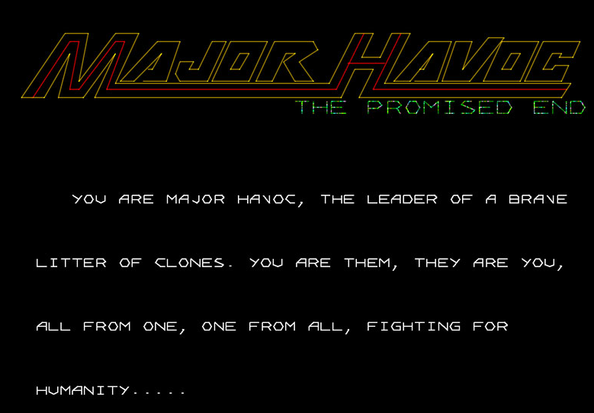

Welcome!
We were here last year… what has really happened?
Last year was the plan, this year is the game
Lotsa Code
Lotsa Time
Notes:
Intro, audience questions etc, thanks and appreciations to all that have helped us so far.
How is this presentation different from last year

Slide 4
Big shoutouts
Jon Koolpe – BETA Tester, Game Hosting, Fixer of all
Bill Gardner – Speech Encoding
Luke Dyson – Repro PCB and hardware help (Luke actually came up with ‘The Promised End’ name idea FYI)
Mark Spaeth – Hardware Advisor

Slide 5
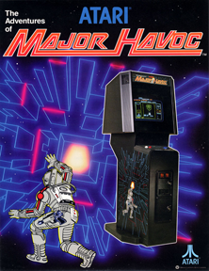
Major Havoc – everyone familiar?
Release by Atari 1983
Created by Owen Rubin
Cannonball
Skydiver
Tunnel Hunt
Orbit
SPACE DUEL

Slide 6
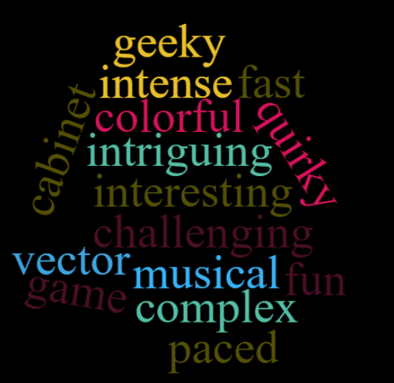
Why do people like Major havoc so much?
Whatever the story, it seemed to evoke
Passion in people
PLUS – The Homeworld seemed to be missing!

Slide 7
What Happened…. Game timeline
It was a complex game
First multi processor game (originally had 2, ended with only 2)
Used lots of memory
Very complex story and gameplay
In development for over 18 months (normal game dev was ~ 6 months)
Release pressures – Arcade crash coming!

Slide 8
Jump to 2017 – The real project begins
Original 1983 Hardware was ‘full’ – not enough program memory space to make additional gameplay.
Scott Swazey wanted to support a ‘New+Extended’ game on an FPGA (hardware simulation platform)
Luke Dyson was going to start making Reproduction Havoc PCB’s.
Owen was interested in reviving some of his old game ideas
Jess wanted to build a robust game that was fun for old and new players!
We decided on how to implement EXPANDED Program Memory space on all platforms!

Slide 9
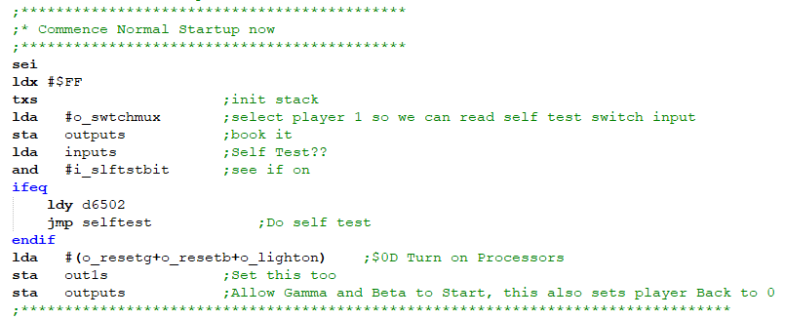
Coding Begins
Documented and Commented all code including Atari RPM (Rusty’s Pokey Music – Sound Library)
Reverse Engineered all ROM images
Verified we could re-compile to match bit for bit on v3 ROM’s

Slide 10
What’s in the BOX?
BIG GOAL FROM OWEN
Put in a ‘Homeworld Battle’…. In our case a GIANT Space Station that has multiple reactors – GIVE THE GAME AN ‘END’.
Restore the STAR CASTLE that had to be removed due to time constraints in play testing.
New Concepts – Targeting ‘Non-Arcade’ players
More Levels, deeper ruleset
Speech
CURRENT STATUS – ABOUT 90% COMPLETE! Final release End of Year 2019!

Slide 11
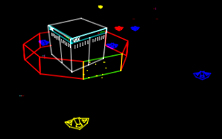
Star Castle + Homeworld SEQUENCE
VAXXIAN enemy is the original VAX mainframe that Owen coded on
‘Star Castle’ + Fighter Battle is space wave before Level 21 – Final Space Station
Final Station is currently 4 full maze ‘sections’
Will have multiple reactors (with a Giant Reactor at the end)
Homeworld sequence for Rex to save his people

Slide 12
8 nEW LEVELS + 4 Final STATION SECTIONS
Needed an interactive way to design levels
Enter the ‘Major Havoc Level Editor’
Jess started this in 2003
Bryan jumped in in 2017 and took over development duties
Jerky started digging in deep on Level design!!!
LEVELS WILL STILL CHANGE AFTER CAX!

Slide 13

Introducing maximilian
Max ‘named from similarity to Black Hole robot’
Was in original Vector ROM’s but not used in code
Is in new levels, he is ‘unstoppable’ (maybe?)
DON’T TRIGGER MAX!

Slide 14
SPEECH!
Owen was inspired by ‘Mother’ from Alien
We are using the original TMS-5220 Speech Chip from Texas Instruments which was used by Atari
Ironically, female speech is *quite difficult* on the TMS-5220 so we are still working on getting this as best as possible for Owen
Currently there are speech samples on the Maze Countdown 10-1 and a few other places

Slide 15
WHERE ARE WE NOW?
90% complete in coding
Play testing of current level designs
Weighing additional new features
Key Pouch
How to get into hidden levels

Slide 16
HOW DO YOU GET INVOLVED?
Playing the game
CAX: Go play Jon’s game in the hall! LOOK FOR GREEN BOOKS!
POST-CAX: Download the ROMS from http://mhedit.askey.org
HBMAME: There is an HBMAME driver ‘mhavocpex’
LEVEL by Level: Major Havoc Level Editor
Will allow you to edit levels and play them individually
Giving feedback -> https://github.com/jessaskey/mhedit/issues

Slide 17
Now Go find the homeworld! Thank you!

Slide 19
Recreating Video Games on an FGPA
Scott swazey
Scott451@gmail.com

Slide 20
How I got started in 2014
Played with MAME / Simh
Software emulation didn’t feel right
Sytse on PDP2011.net
Built a PDP 11/34 running RSTS/E V7 on a Cyclone IV DE0nano from his source
Studied his design and learned VHDL. Contributed bug fixes.
Mike J on Fpgaarcade.com
Studied vhdl for asteroids and Pacman. Contributed bug fixes.
SpritesMods.com
Black widow on an FPGA (largely based on MikeJ’s work)
VicVector
Incomplete, non-working grad student attempt to port Tempest to an FPGA and drive a laser display.

Slide 21
Recreating a video game on an fpga
What doesn’t work
Describe original schematic as VHDL code.
Original designs are asynchronous.
Original designs are glitchy
Orignal designs have clever logic/timing.
Most peripherals use edges of address and RD/WR strobes to latch data.
Makes for a very unstable design. (i.e. unrelated functions stop working when you change something else)
Edge driven latches consume clock resources.
What you have to do, synchronize
Use one clock for everything
Makes timing closure much easier
Use “Enable” signals to divide down the clock.

Slide 22
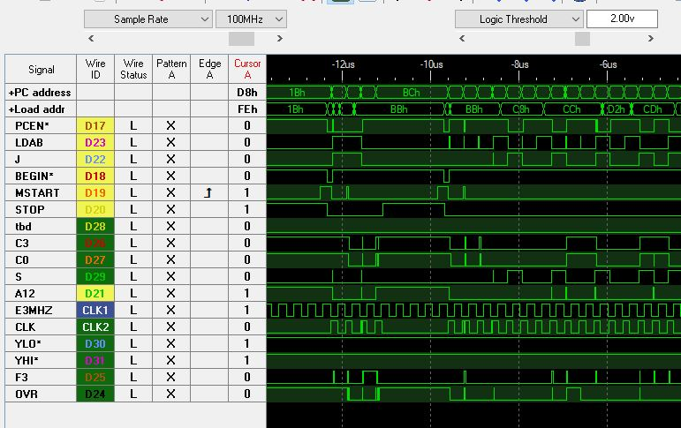

Slide 23
My initial HW design flow
VHDL using Quartus IDE from Intel/Altera
Write VHDL
Add SignalTap signals (a “compiled in” logic analyzer)
Synthesize/Assemble/Route/Place (2-3 minutes)
Download to target hardware
Evaluate/debug design
Modify VHDL/signal taps
Repeat.
Handy tools (via jtag)
SignalTap
Memory content editor
Probes and sources

Slide 24
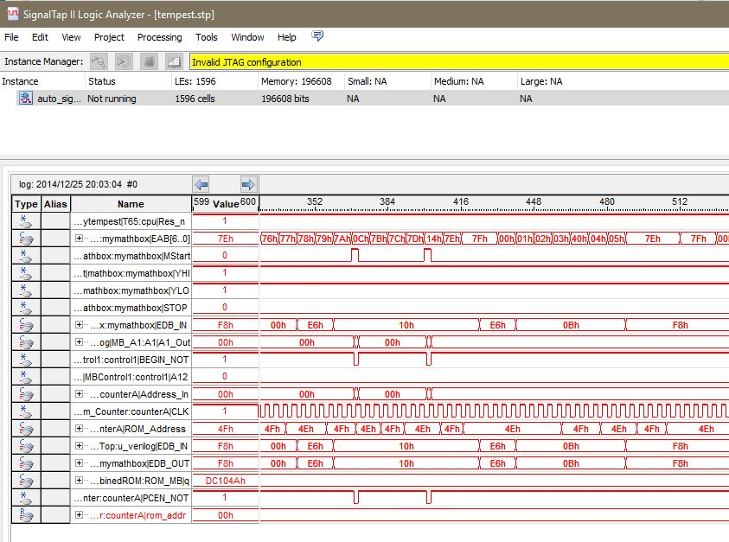

Slide 25
My current design flow
Move all development into simulator (Model Sim)
Significant advantages.
Compile time is in seconds not minutes
All signals are available to the logic analyzer at any time
Signals can be forced to a level at anytime during the simulation
STD_LOGIC_TEXTIO allows signals to be printed to the console or a file
STD_LOGIC_TEXTIO can be combined with SVG XML to graph actual
Disadvantages
Memory content editor is not available…

Slide 26
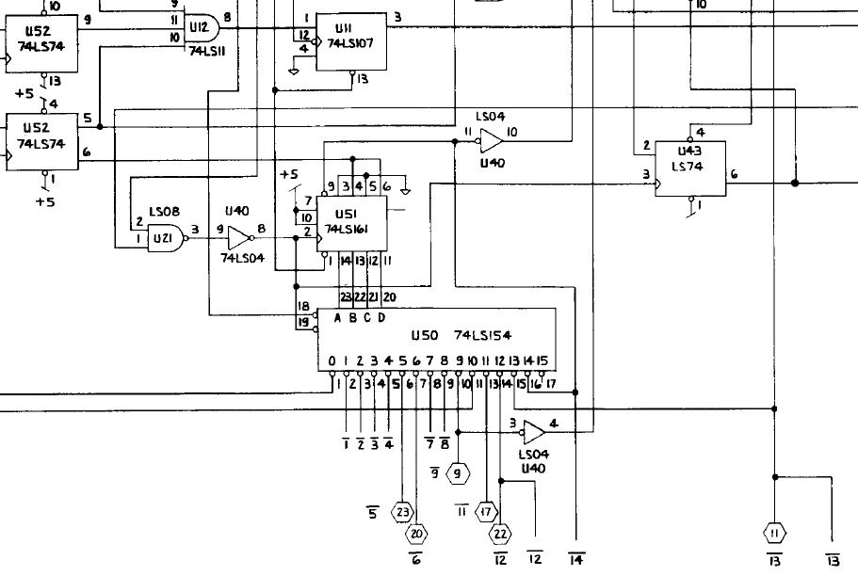
Sega G80 state machine phase decoder

Slide 27
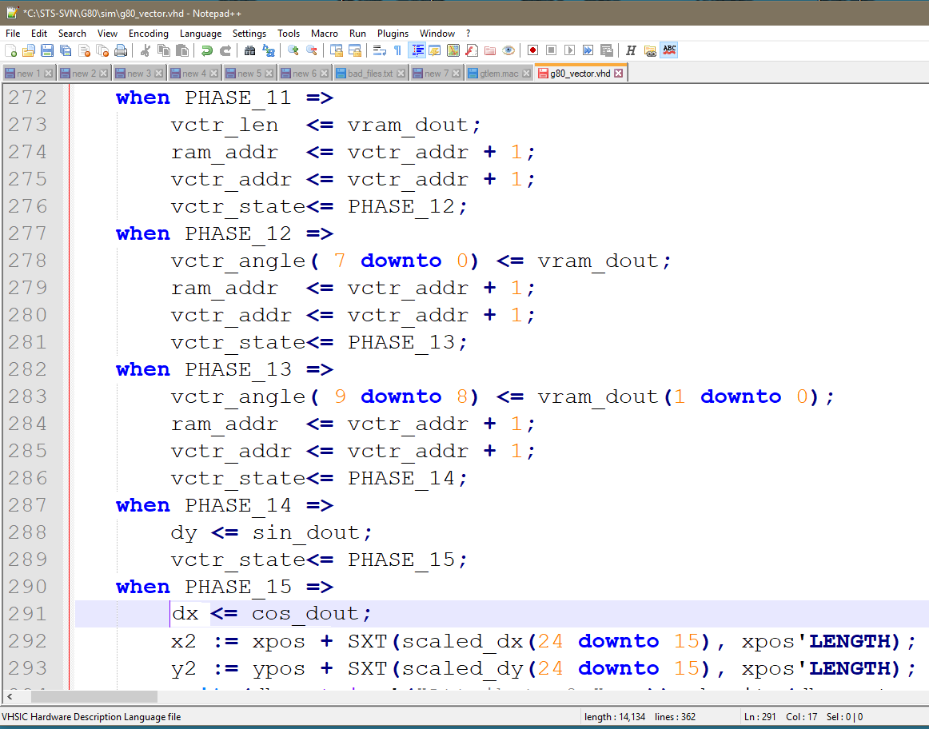

Slide 28
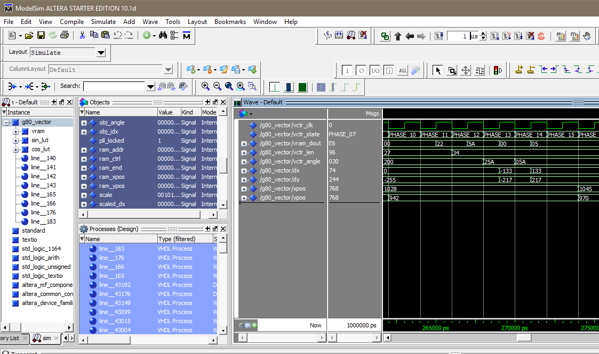

Slide 29
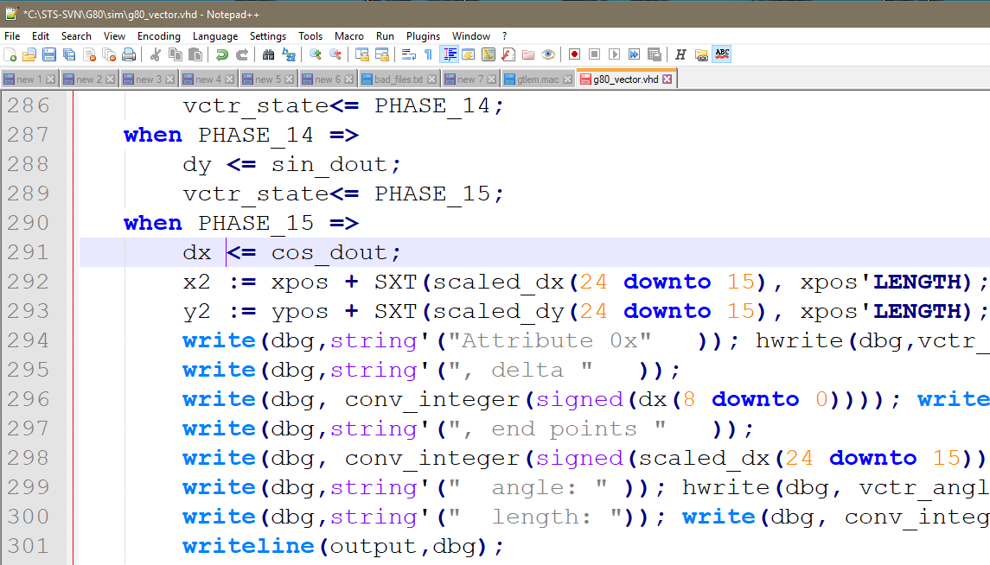

Slide 30
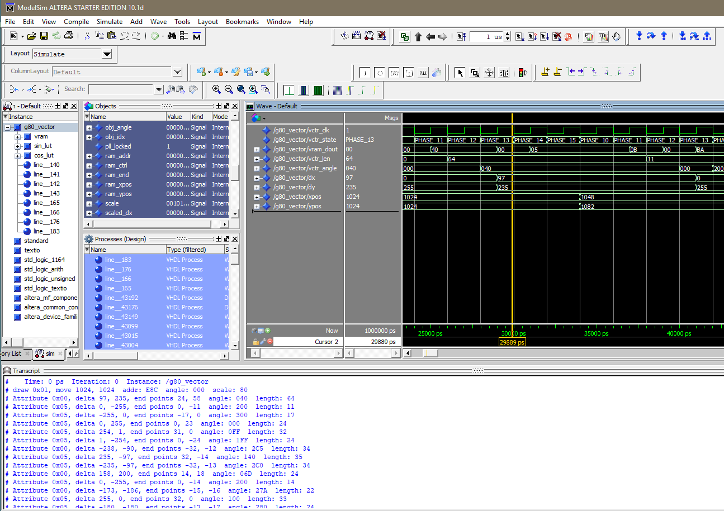
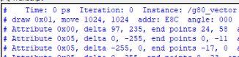

Slide 31
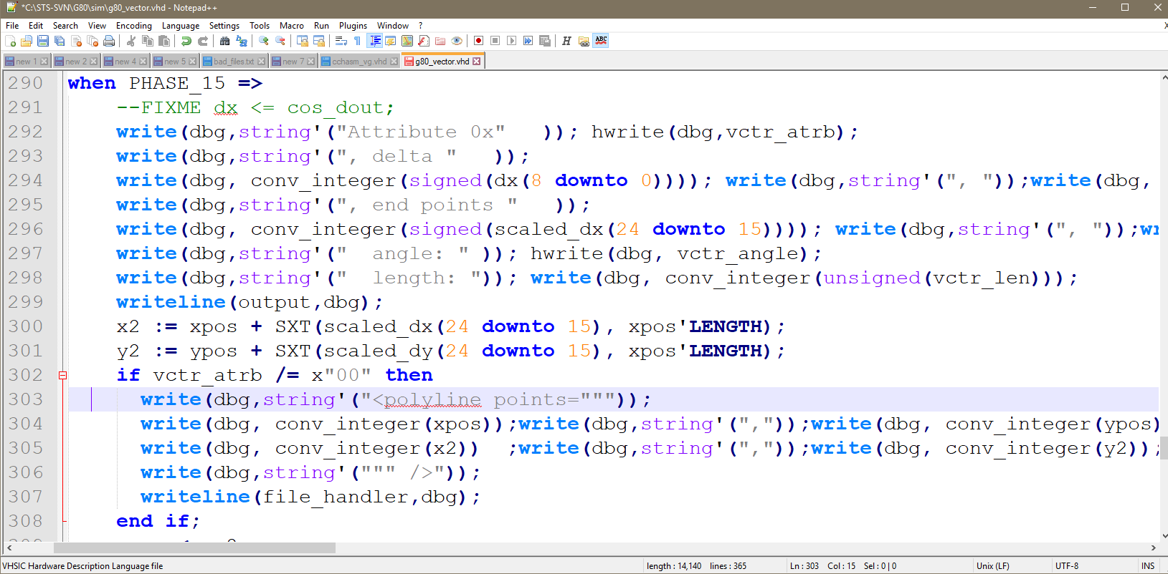

Slide 32
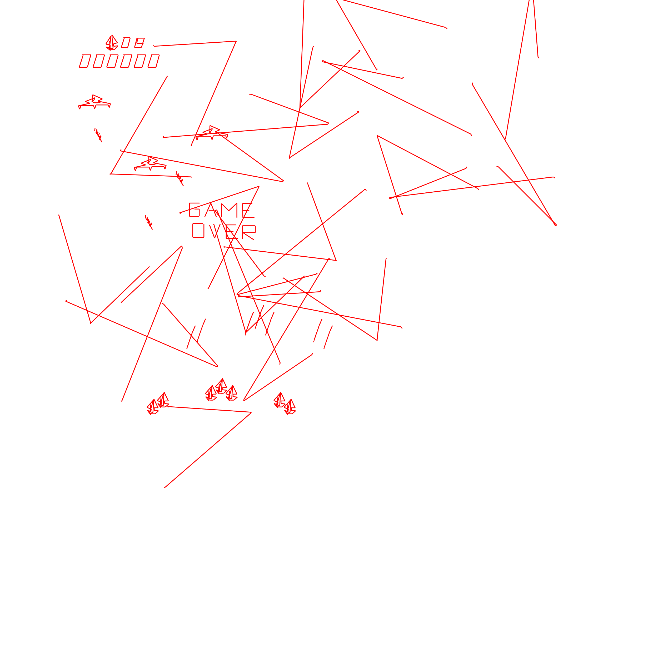

Slide 33
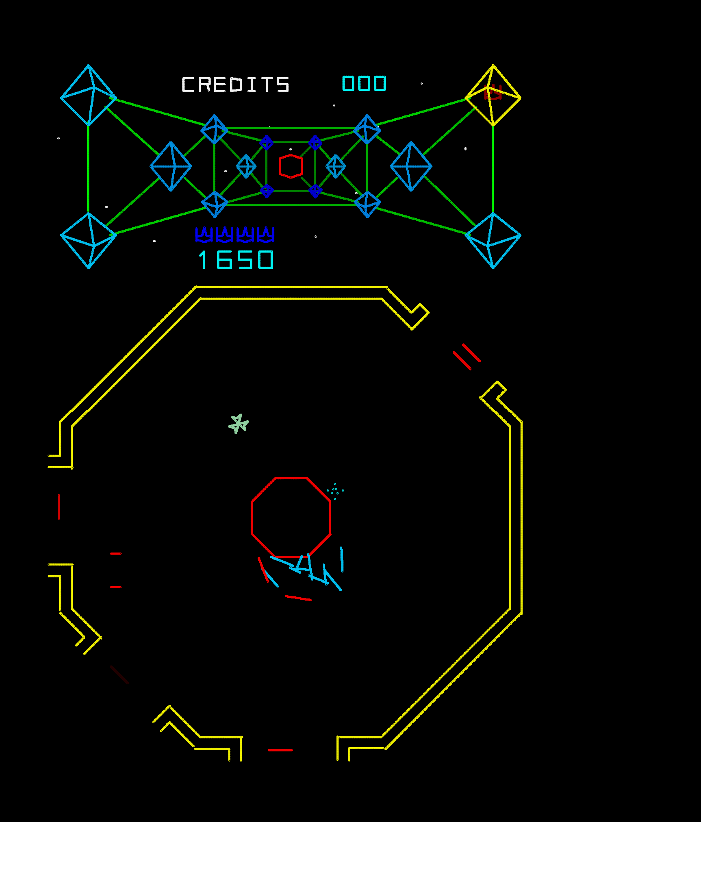

Slide 34
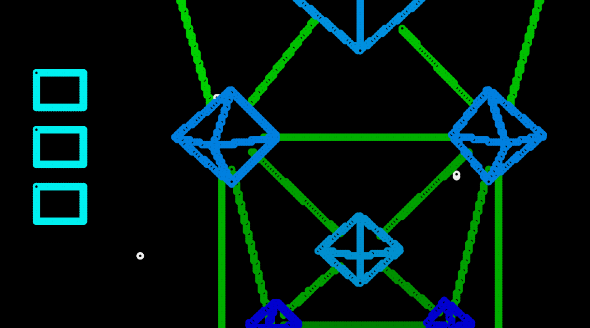

Slide 35
